Slide 1
The Relationship of High Tech Jobs to Non Tech Jobs on National and State Levels
Albert Ofori, Bright Tsevi, Dameon Turner and Sonya Worrell

Slide 2
What to Expect in this Presentation
Overview
Annual Salaries Comparison
Top 10 High Paying States (Rankings)
Purpose of project
Questions to investigate
Annual Salaries - United States
Annual Mean Salaries
Charts utilized
Results
Annual Salaries - Individual States
Annual Mean Salaries
Charts utilized
Results
Top 10 Lowest Paying Tech States(Rankings)
Current number of High Tech Jobs Nationally and by State
Total employment
Tech vs Non-tech jobs
Charts utilized
Results
Notes:
The first dataset stateM2019.
Imported the data
“*, ** files were replaced with Na values
3 area type
Area type 2 States
US Minority Islands
Filtered by occupational groups
TOTAL is for everyone
Major
Detailed occupations
We decided to focus on the detailed group (per job level)
Key - Replaced hourly values with hash $100
Replaced annual values with $208,000
Cleaned out the salary columns ( done as strings… Took out all $ signs and ____ signs)
Dropped values NA values 0 ( found the indices we dropped the rules that have an Na value in them - left with no NA values with the columns
Calculated the values of the annual means salary to find the weekly salaries for each state /
Filter out the TEch / Non Tech jobs
Keywords are defined to ( all of the high tech job titles)
Add additional column (N/Y) filtered technical/non technical jobs
Histogram (proportional/ individuals - % finding a high tech jobs vs non tech jobs)
Outliers (near zero)
Boxplot (tech jobs vs non tech jobs) nontech jobs have more outliers //

Slide 3
Overview
Questions Researched
How many High Tech and Non Tech Jobs are currently in the US both Nationally and by State?
What are the Annual Salaries of High Tech versus Non - Tech positions both nationwide and by State?
Which State has the highest salaries for high tech jobs?
Which State has the lowest salaries for high tech jobs?

Slide 4
Considerations
IMPORT DATA AND REPLACE * AND ** WITH NaN
FILTER ONLY US STATES
DEFINE FUNCTION TO REPLACE ALL # VALUES 100 FOR ALL HOURLY RATE COLUMNS AND 208000 FOR ANNUAL SALARY COLUMNS
REPLACE '#' VALUES WITH AFOREMENTIONED VALUES
DEFINE FUNCTION TO LOOP THROUGH COLUMNS OF INTEREST
FIND INDICES WITH NULL VALUES
REMOVE ROWS AND NULL VALUE INDICES
REMOVE UNWANTED CHARACTERS
CAST CLEANED COLUMNS AS FLOAT
CLEAN ALL COLUMNS OF INTEREST
ENSURE ALL COLUMNS OF INTEREST HAVE NON-NULL VALUES

Slide 5

Considerations - Data Cleaning

Slide 6
Total High Tech and Non Tech Jobs Nationally and by State

Slide 7
Total High Tech and Non Tech Jobs Nationally and by State
Dataset Utilized
U.S. Bureau of Labor Statistics, May 2019 Occupation Profiles: STEM versus non-STEM professions
Visual Representation
Bar Chart
Stacked Bar Chart
Results
Results of the total number of high tech jobs on both the national level and State level [ top 10 and the least 10 noted ]

Slide 8
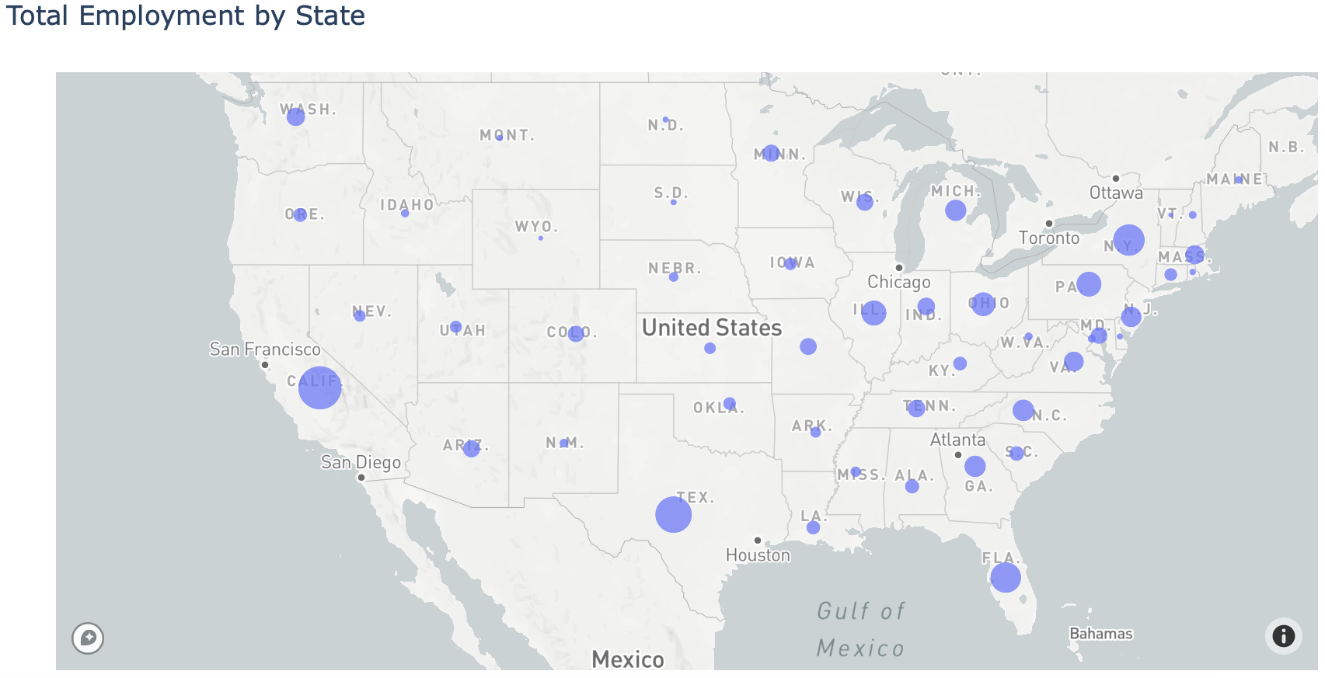
Employment by State

Slide 9
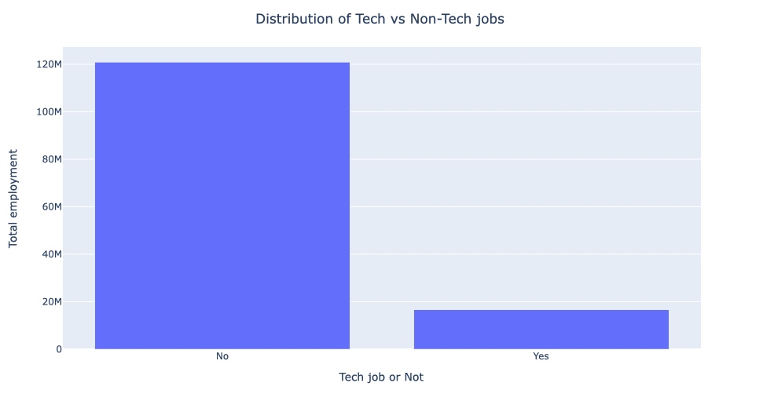
Distribution of Tech vs Non-Tech Jobs

Slide 10
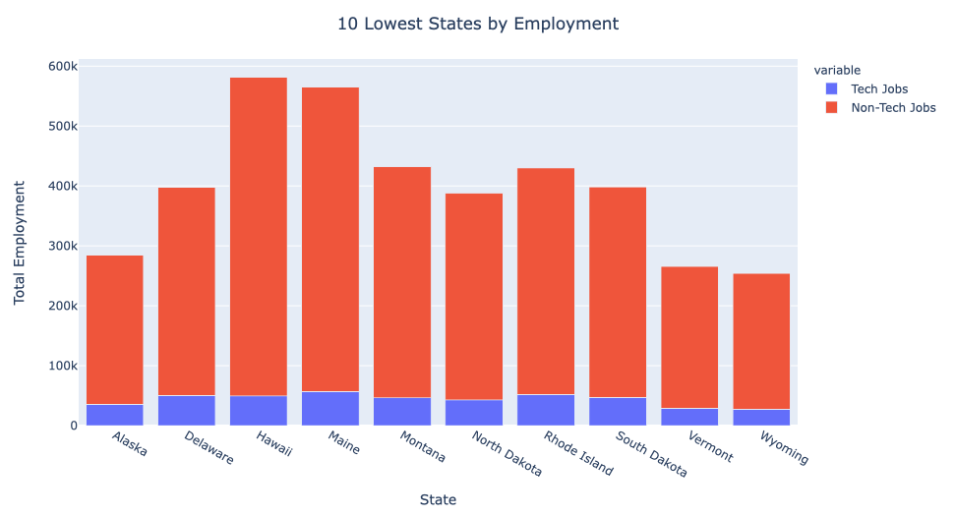
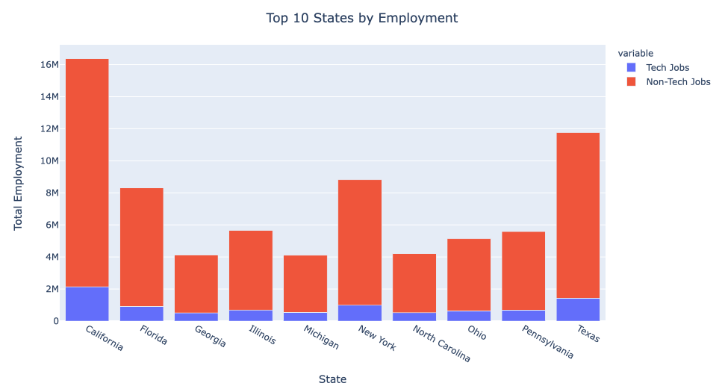
Total Jobs by State

Slide 11
High Tech vs Non Tech Salary

Slide 12
High Tech vs Non Tech Salary
Dataset Utilized
U.S. Bureau of Labor Statistics, May 2019 Occupation Profiles: STEM versus non-STEM professions
Visual Representation
Box plot
Results
Tech jobs have the higher median annual salary than non tech. Non tech have more outliers

Slide 13
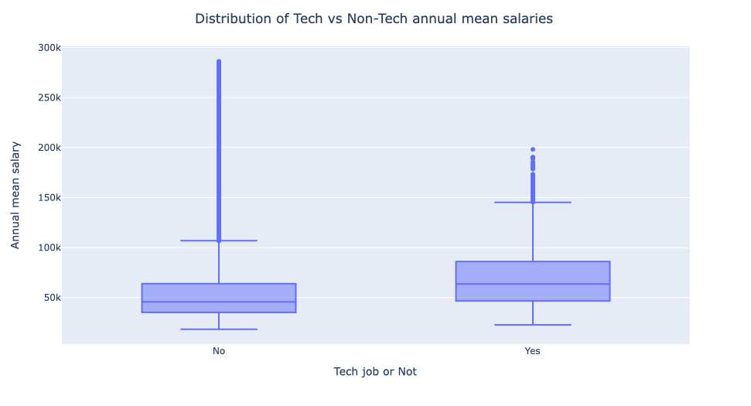
Distribution of Tech vs Non-Tech annual mean salaries

Slide 14
Annual Salaries Comparison

Slide 15
Annual Means Salaries Comparison
Dataset Utilized
U.S. Bureau of Labor Statistics, May 2019 Occupation Profiles: STEM versus non-STEM professions
Visual Representation
Histogram
Results
The probability of getting a job <$50K is higher compared to high tech jobs.
Salary Range: $50K - $150K there’s a higher probability of availability versus the probability of finding a non tech job in this salary range.
There are a few outliers of non tech jobs the are in the higher salary range.

Slide 16
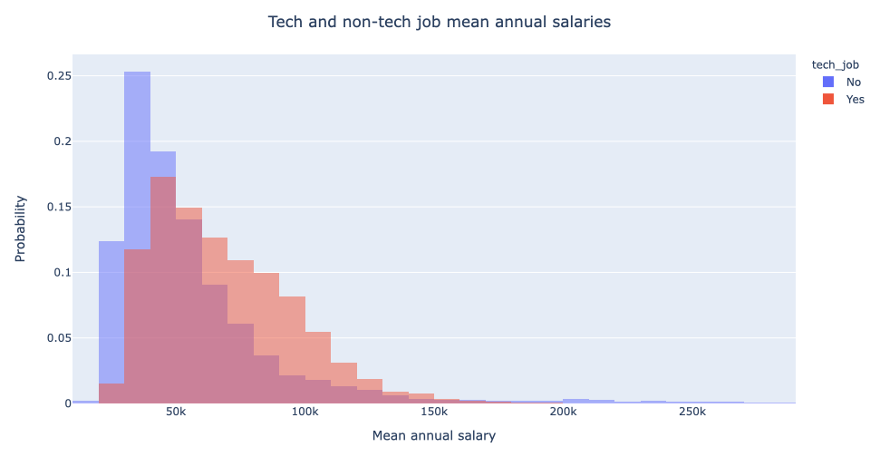
Tech and non-tech job mean annual salaries

Slide 17
Top 10 High Paying Tech States

Slide 18
Top 10 High Paying States (Rankings)
Dataset Utilized
U.S. Bureau of Labor Statistics, May 2019 Occupation Profiles: STEM versus non-STEM professions
Considerations
Bar Chart
Results
The highest paying salaried States(Rankings):
District of Columbia
California
New York
Washington
New Jersey
Massachusetts
Connecticut
Alaska
Rhode Island
Hawaii

Slide 19
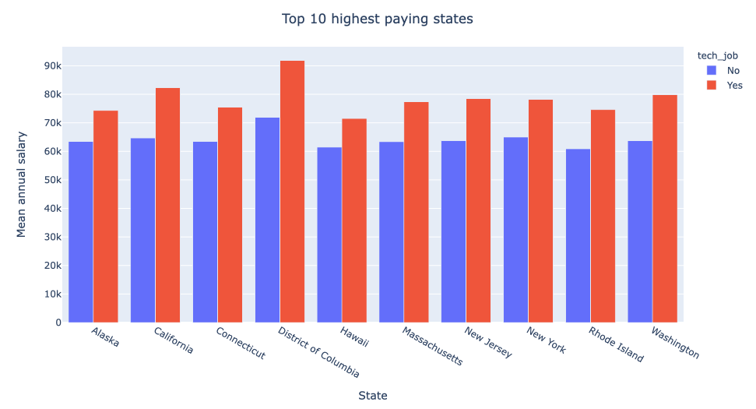
Top 10 High Paying States

Slide 20
Top 10 Lowest Paying Tech States

Slide 21
Top 10 Lowest Paid Tech States
Dataset Utilized
U.S. Bureau of Labor Statistics, May 2019 Occupation Profiles: STEM versus non-STEM professions
Visual Representation
Bar Chart
Results
Mississippi
Arkansas
West Virginia
South Dakota
Alabama
Kentucky
Oklahoma
Louisiana
Tennessee
Idaho

Slide 22
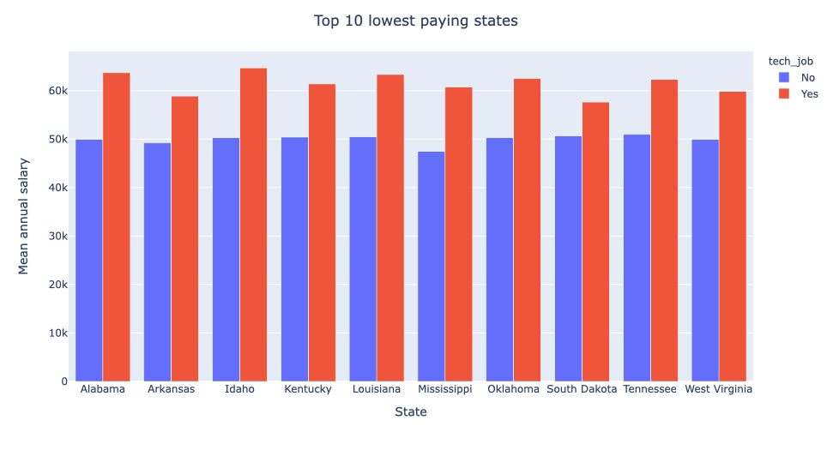
Top 10 Lowest Paid Tech States

Slide 23
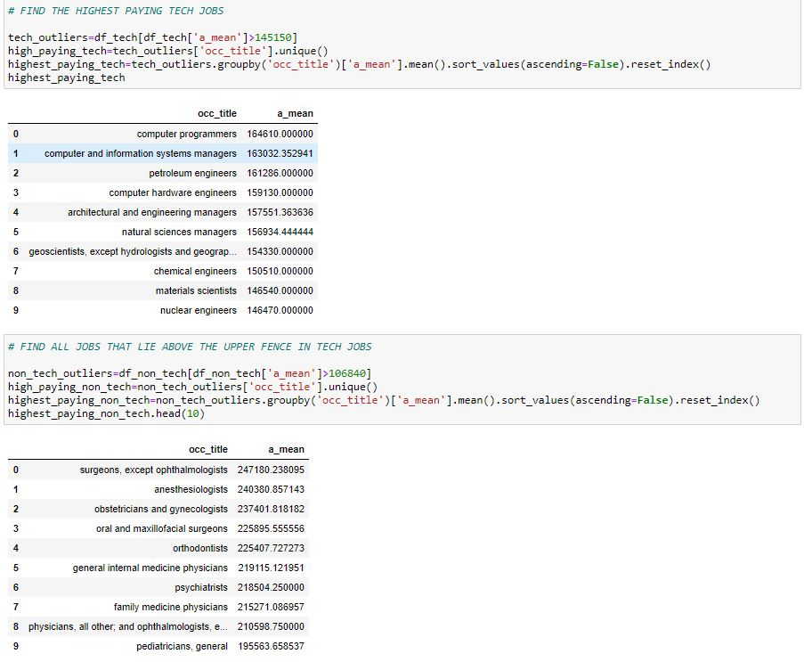
Interesting Fact
Jobs in STEM pay high prices but not compared to the medical field

Slide 24


